Slide 1
Chapter 8 Operating Systems and Utility Programs

Slide 2
Chapter 8 Objectives
Identify the types of system software
Summarize the features of several stand-alone operating systems
Summarize the startup process on a personal computer
Identify various network operating systems
Describe the functions of an operating system
Identify devices that use several embedded operating systems
Discuss ways that some operating systems help administrators control a network and administer security
Explain the purpose of several stand-alone utility programs
Explain the purpose of the utilities included with most operating systems
Next

Slide 3
System Software
What is system software?
Programs that control or maintain operation of computer
Two types are; operating systems and utility programs
Operating system (OS) (sometimes called the platform) coordinates all activities among computer hardware resources
p. 398 - 399
Next

Slide 4
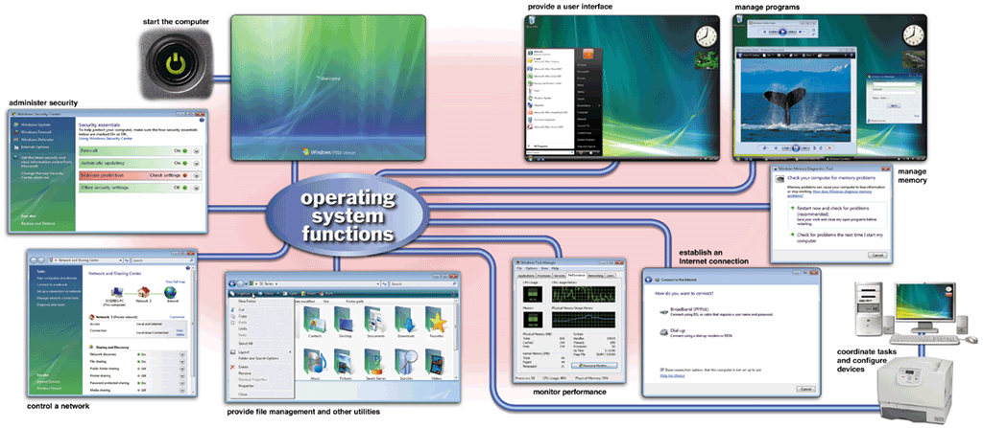
Operating Systems
What are the functions of an operating system?
p. 398 - 399 Fig. 8-1
Next

Slide 5
Operating Systems
What is a cross-platform application?
Runs the same on multiple operating systems
Application
Operating System/ Platform A
Operating System/ Platform B
Operating System/ Platform C
Operating System/ Platform D
p. 399
Next

Slide 6
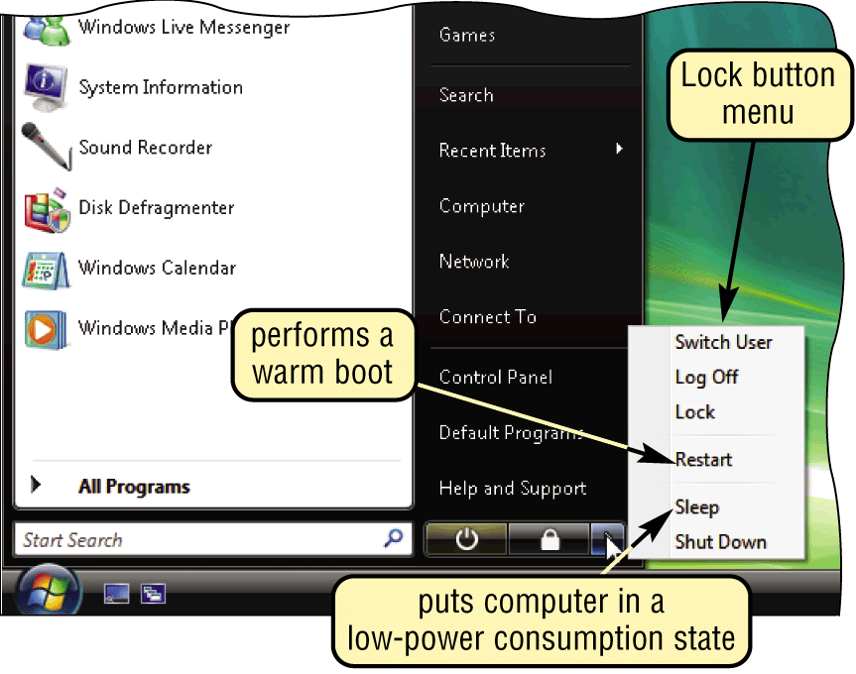
Operating System Functions
What is booting?
Process of starting or restarting a computer
Cold boot Turning on computer that has been powered off
Warm boot Restarting computer that is powered on
p. 400 Fig. 8-2
Next

Slide 7
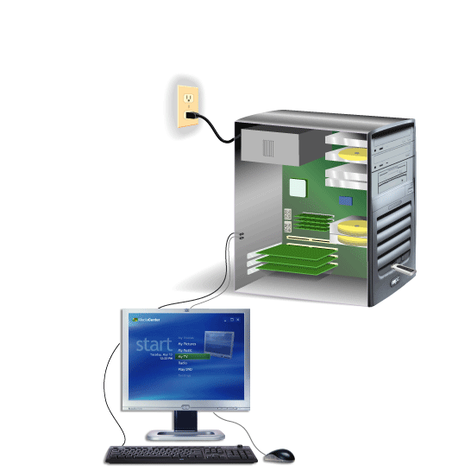
Operating System Functions
How does a personal computer boot up?
Step 1. Power supply sends signal to com-ponents in system unit
Step 4. Results of POST are compared with data in CMOS chip
Step 5. BIOS looks for system files on a USB flash drive or CD/DVD drive, and then drive C (hard disk)
Step 2. Processor accesses BIOS to start computer
Step 3. BIOS runs tests, called the POST, to check components such as mouse, keyboard, and adapter cards
Step 6. Kernel (core) of operating system loads into RAM
Step 7. Operating system loads configuration information and displays desktop on screen
Click to view Web Link, click Chapter 8, Click Web Link from left navigation, then click Windows Registry below Chapter 8
p. 400 - 401 Fig. 8-3
Next

Slide 8
Operating System Functions
What is a boot disk?
Contains system files that will start computer when computer cannot boot
Also called recovery disk
p. 402
Next

Slide 9
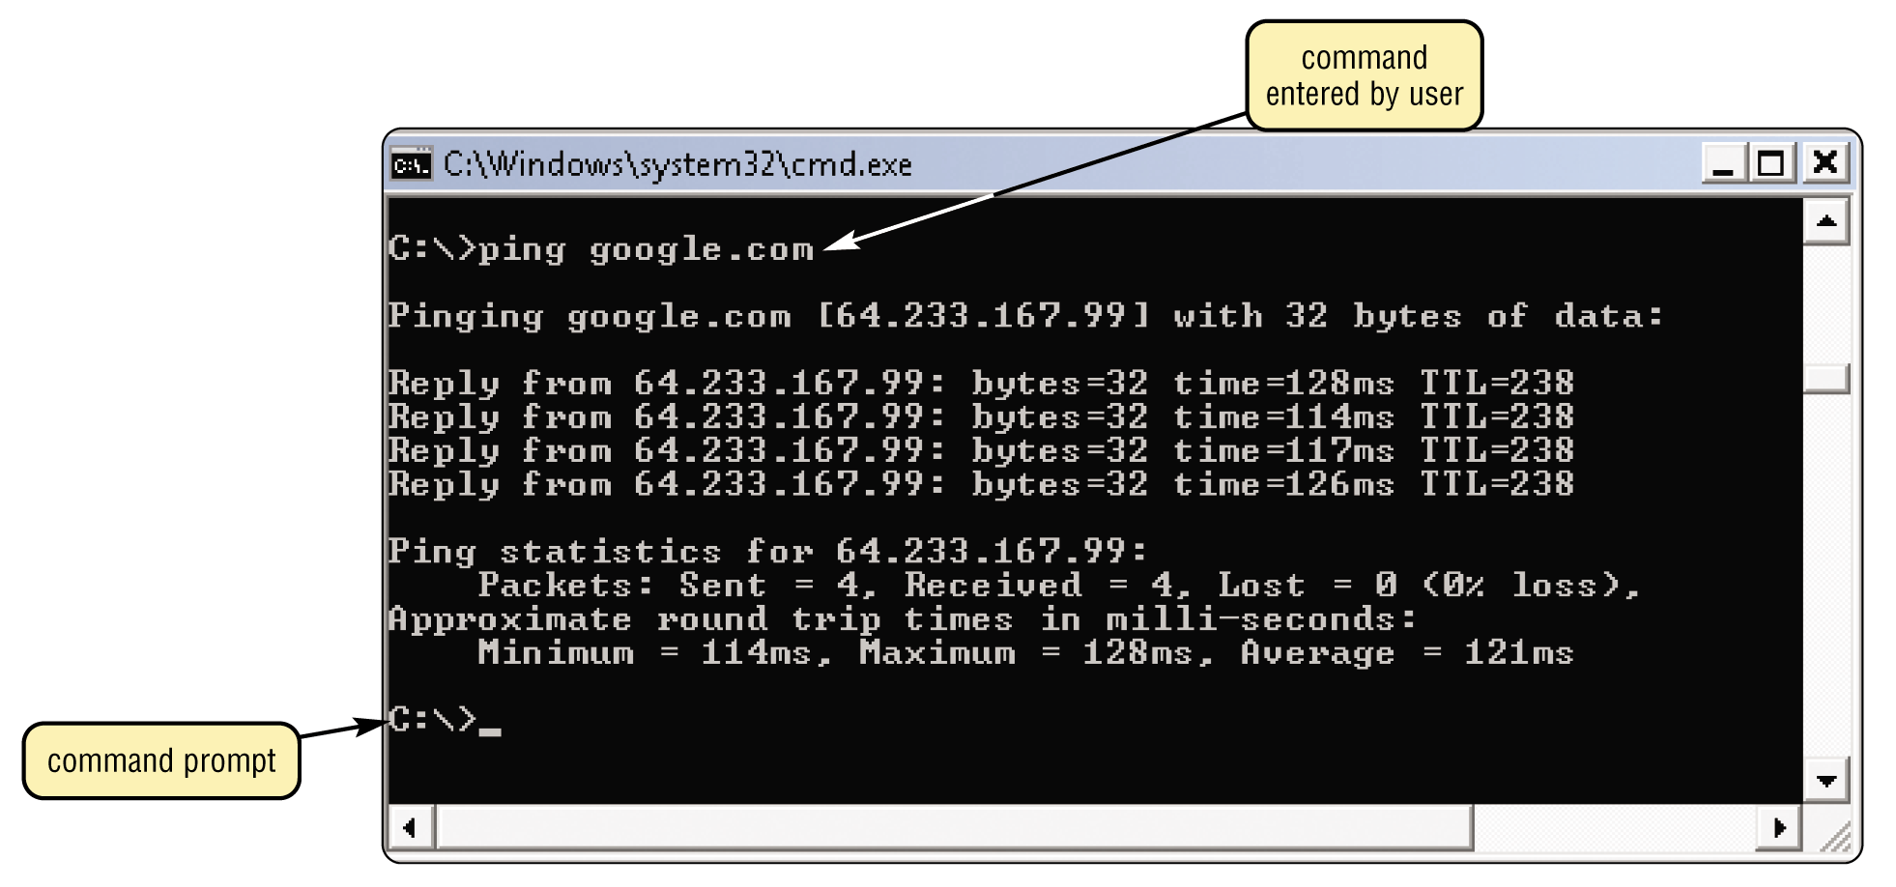
Operating System Functions
What is a user interface?
Controls how you enter data and instructions and how information displays on screen
p. 402 Fig. 8-4
Next

Slide 10
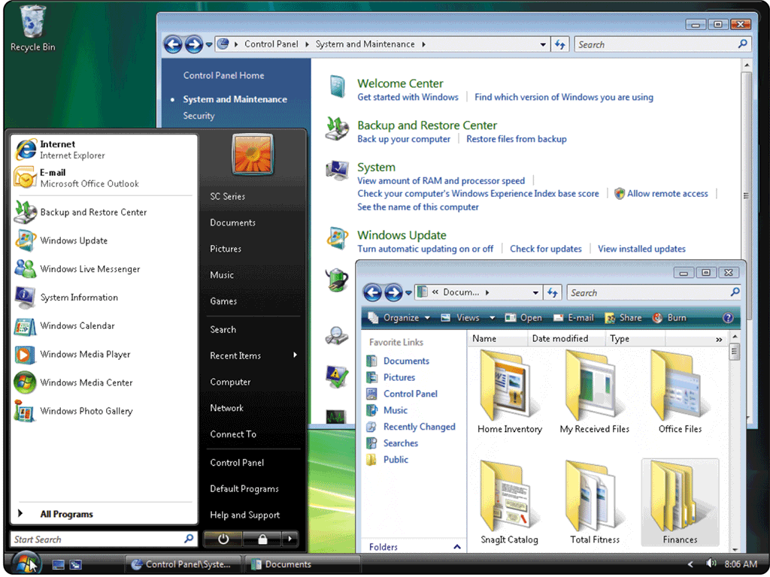
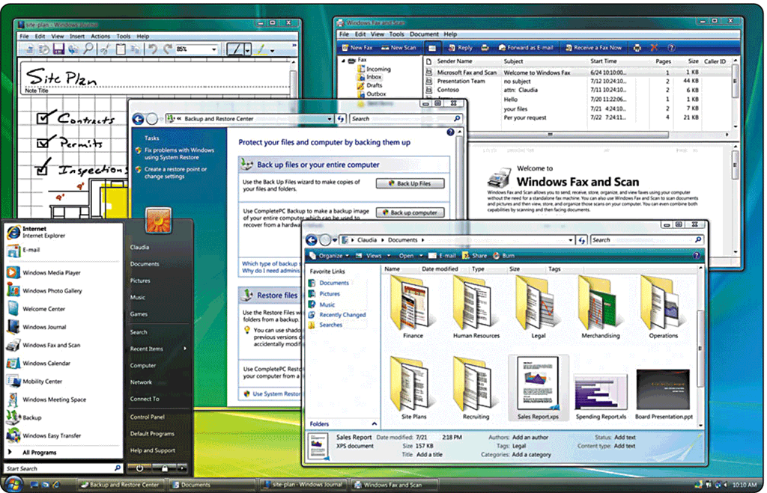
Operating System Functions
What is a graphical user interface (GUI)?
User interacts with menus and visual images such as buttons and other graphical objects
Basic Interface
Windows Aero Interface
p. 403 Fig. 8-5a and 8-5b
Next

Slide 11
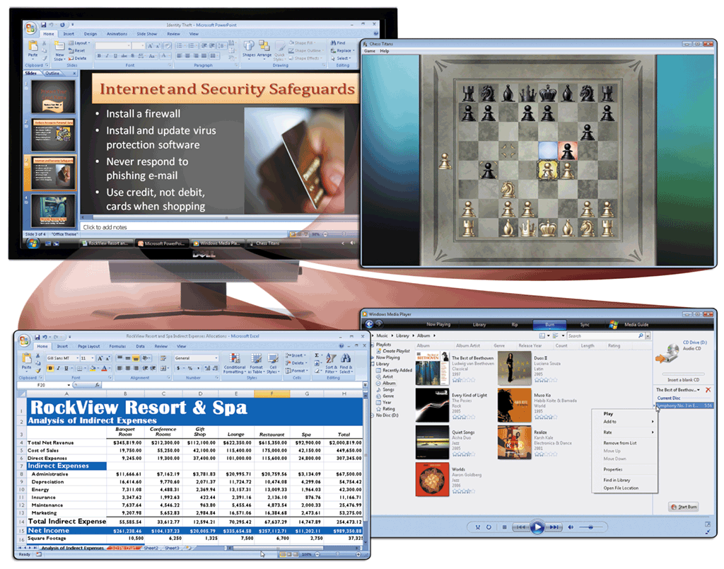
Operating System Functions
What is single user/ multitasking?
Working on two or more programs that reside in memory at same time
Foreground contains program you are using
Background contains programs that are running but are not in use
p. 403 - 404 Fig. 8-6
Next

Slide 12
Operating System Functions
What are other program management features of operating systems?
Enables two or more users to run programs simultaneously
multiprocessing
Can support two or more processors running programs at same time
multiuser
Has duplicate components such as processors, memory, and disk drives
fault-tolerant computer
Continues to operate when one of its components fails
p. 405
Next

Slide 13
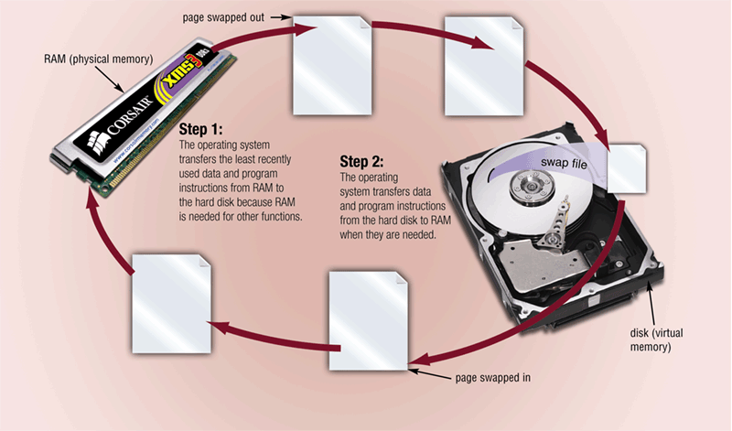
Operating System Functions
What is memory management?
Optimizing use of random access memory (RAM)
With virtual memory (VM), portion of hard disk is allocated to function as RAM
p. 405 - 406 Fig. 8-8
Next

Slide 14
Operating System Functions
How does an operating system schedule jobs?
Adjusts schedule based on job’s priority
Receiving data from input device
Sending information to output device
A job is an operation the processor manages
Processing instructions
Transferring items between storage and memory
p. 407
Next

Slide 15
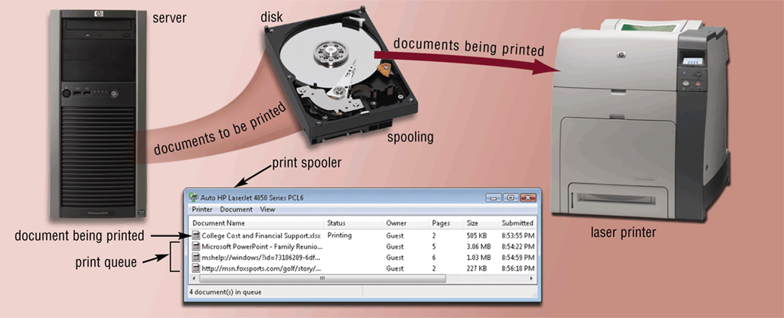
Operating System Functions
What is spooling?
Sending print jobs to buffer instead of directly to printer
Print jobs line up in queue
p. 407 Fig. 8-9
Next

Slide 16
Operating System Functions
What is a device driver?
Program that tells operating system how to communicate with device
With Plug and Play, operating system automatically configures new devices as you install them
Device Driver
Also called driver
Click to view Web Link, click Chapter 8, Click Web Link from left navigation, then click Plug and Play below Chapter 8
p. 407
Next

Slide 17
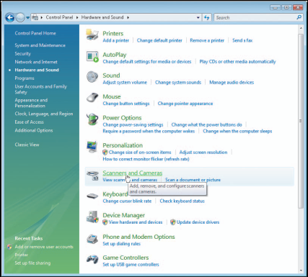
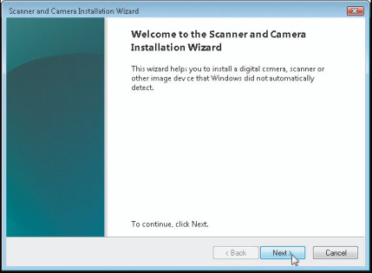
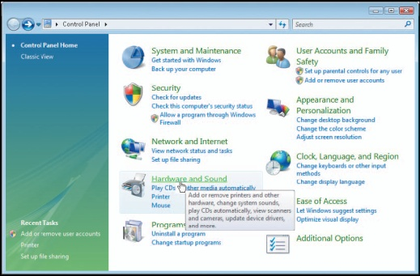
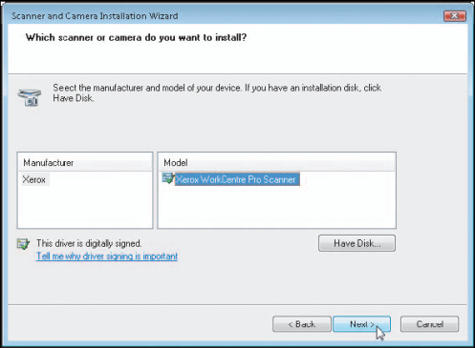
Operating System Functions
How do you install a device driver?
Step 3. Click the Scanners and Cameras link to display the Scanners and Cameras dialog box. Point to the Add Device button.
Step 4. Click the Add Device button to start the Scanner and Camera Installation Wizard. Point to the Next button.
Step 1. Open Control Panel window. Point to Hardware and Sound link.
Step 2. Click the Hardware and Sound link to display the Hardware and Sound options. Point to the Scanners and Cameras link.
Step 5. Click the Next button to proceed with the wizard. Select the correct manufacturer and model of scanner or camera. Follow the on-screen instructions to complete installation of the necessary driver files for the selected device.
p. 408 Fig. 8-10
Next

Slide 18
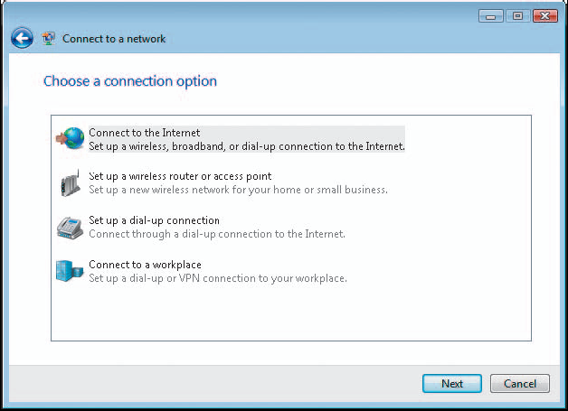
Operating System Functions
How do you establish an Internet connection?
Windows Vista includes Connect to a network wizard
Guides user through setting up connection between computer and Internet service provider
p. 409 Fig. 8-11
Next

Slide 19
Operating System Functions
How does an operating system monitor performance?
Provides program, called performance monitor, that assesses and reports information about system resources and devices
p. 409 Fig. 8-12
Next

Slide 20
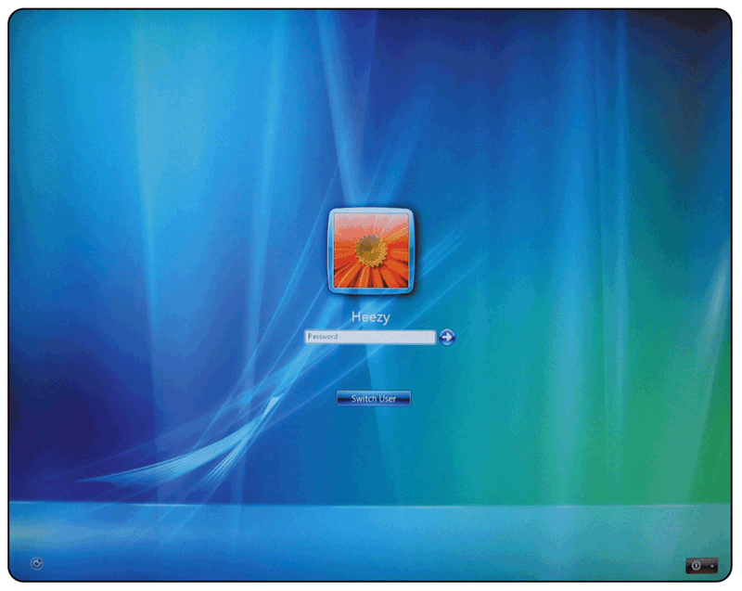
Operating System Functions
What is a network operating system?
Allows users to share resources on a network
Administers security by establishing user name and password for each user
p. 410 Fig. 8-13
Next

Slide 21
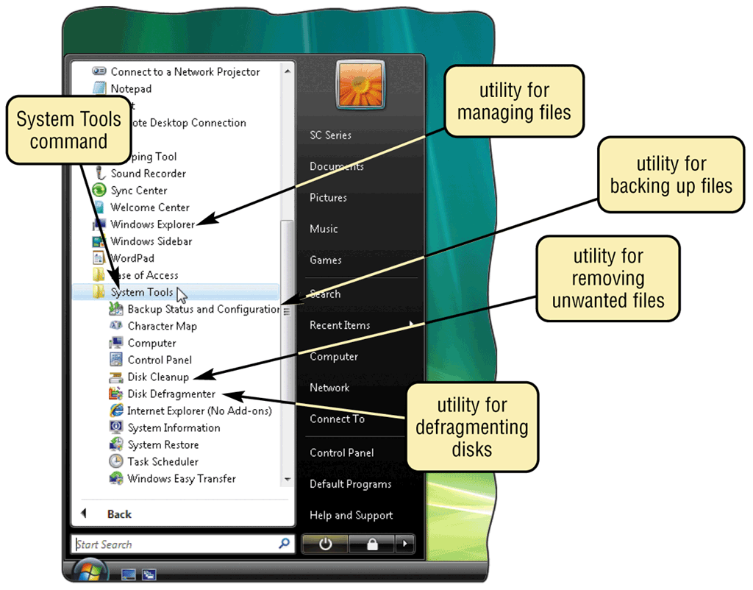
Operating System Utility Programs
What is a utility program?
System software that performs maintenance-type tasks
Also called utility
p. 411 Fig. 8-14
Next

Slide 22
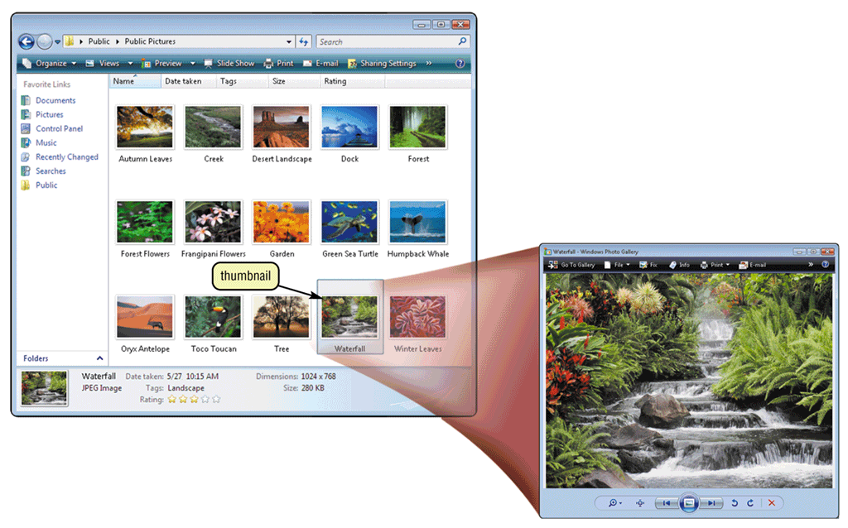
Operating System Utility Programs
What is a file manager?
Performs functions related to file management
Search utility attempts to locate files on your computer
Image viewer displays, copies, and prints contents of graphics file
p. 412 Figs. 8-15–8-16
Next

Slide 23
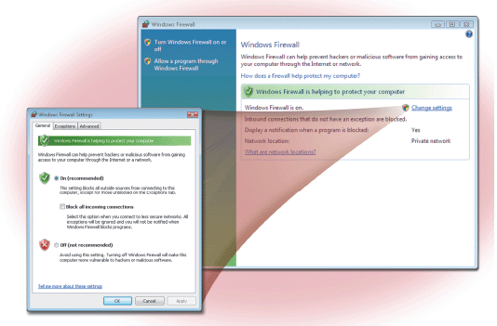
Operating System Utility Programs
What is a personal firewall?
Detects and protects a personal computer from unauthorized intrusions
Windows Vista automatically enables the built-in personal firewall upon installation
Click to view Web Link, click Chapter 8, Click Web Link from left navigation, then click Personal Firewalls below Chapter 8
p. 413 Figs. 8-17
Next

Slide 24
Operating System Utility Programs
What is an uninstaller?
Removes a program and all associated files
In Windows Vista, uninstaller is available through the Uninstall a program command in the Control Panel
p. 413
Next

Slide 25
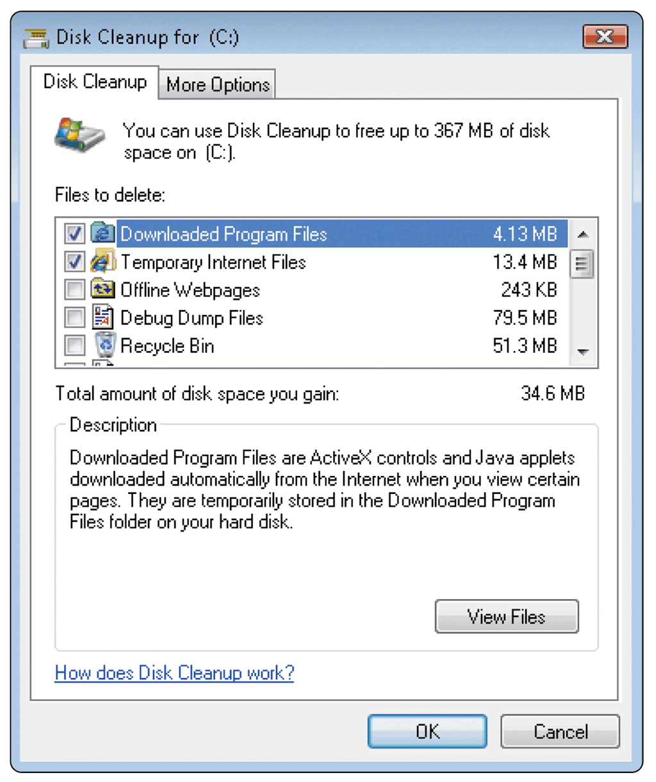
Operating System Utility Programs
What is a disk scanner?
Searches for and removes unnecessary files
Windows Vista includes Disk Cleanup
p. 414 Fig. 8-18
Next

Slide 26
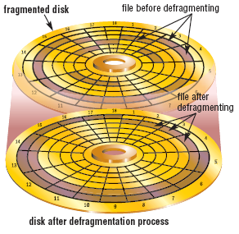
Operating System Utility Programs
What is a disk defragmenter?
Reorganizes files and unused space on hard disk so that programs run faster
p. 414 Fig. 8-19
Next

Slide 27
Operating System Utility Programs
What is a diagnostic utility?
Compiles technical information about hardware and some software
Prepares report outlining problems
p. 414
Next

Slide 28
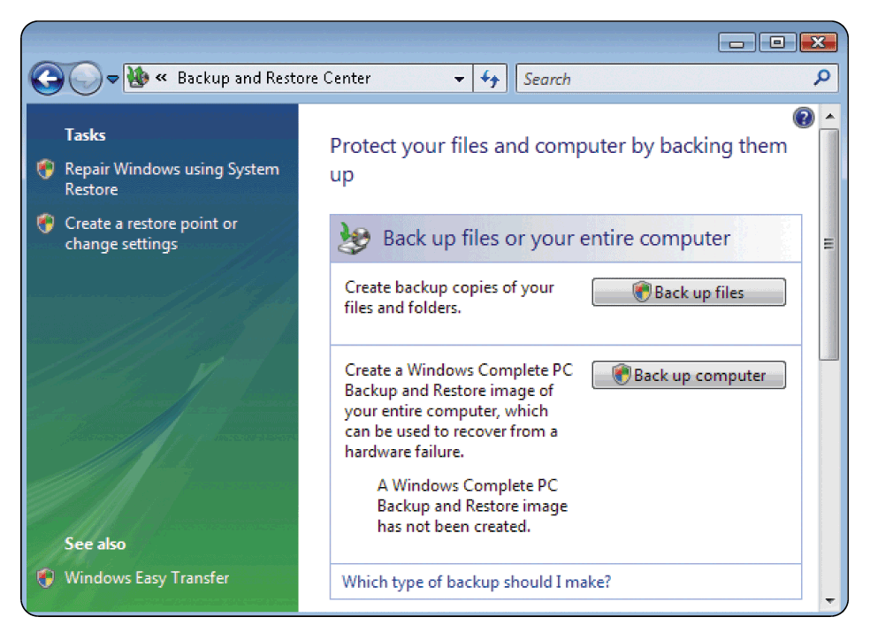
Operating System Utility Programs
What is a backup utility?
Copies selected files or entire hard disk onto another storage medium
Most compress files during backup to require less storage space
p. 415 Fig. 8-20
Next

Slide 29
Stand-Alone Utility Programs
What is a file compression utility?
Shrinks size of files to free up room and improve performance
Compressed files are sometimes called zipped files
Two popular utilities: PKZIP and WinZip
p. 427
Next

Slide 30
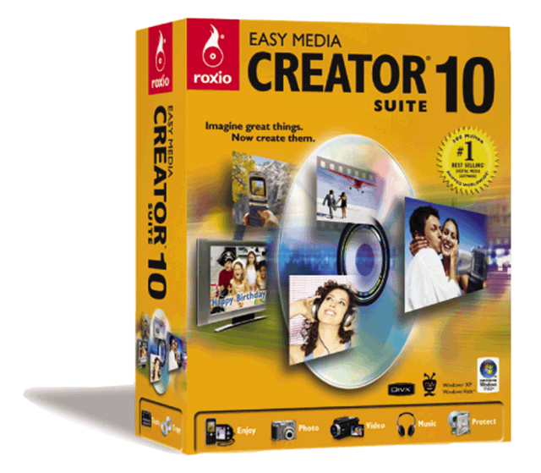
Stand-Alone Utility Programs
What is CD/DVD burning software?
Writes text, graphics, audio, and video files to a recordable or rewriteable CD or DVD
p. 428 Fig. 8-39
Next

Slide 31
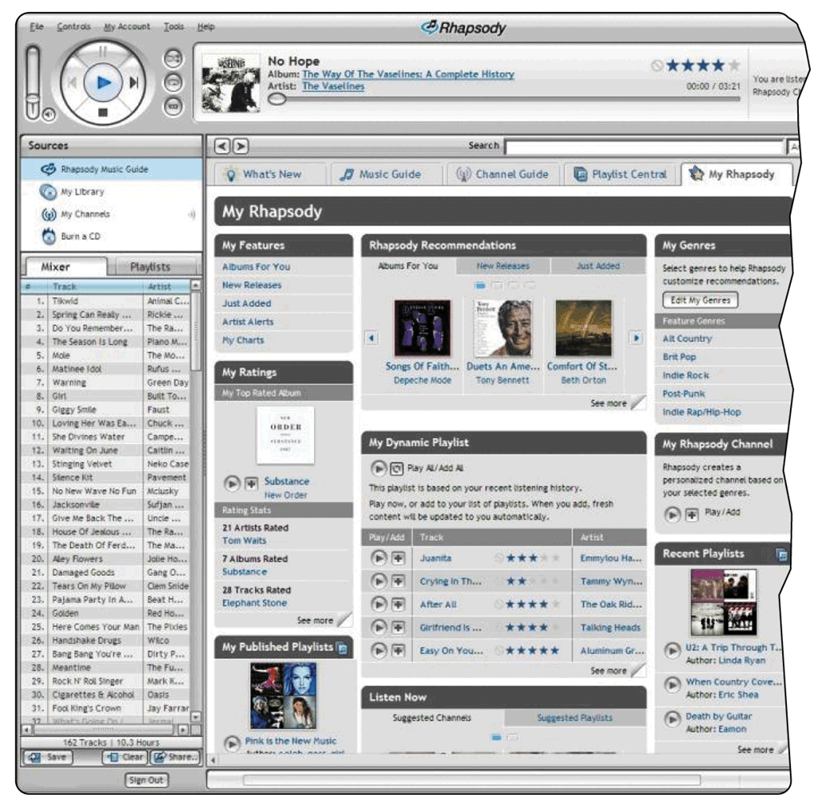
Stand-Alone Utility Programs
What is a media player?
Allows you to view images and animation, listen to audio, and watch video files on your computer
p. 428 Fig. 8-38
Next

Slide 32
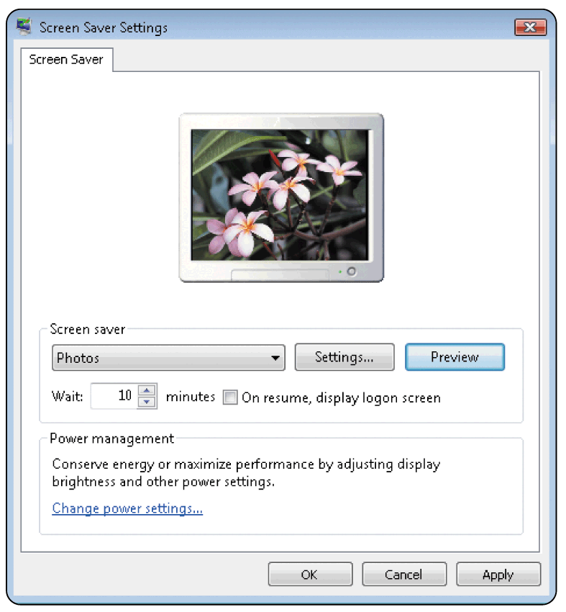
Operating System Utility Programs
What is a screen saver?
Causes monitor’s screen to display moving image or blank screen if there is no activity for a specified time
To secure computer, user configures screen saver to require password to deactivate
Click to view Web Link, click Chapter 8, Click Web Link from left navigation, then click Screen Savers below Chapter 8
p. 415 Fig. 8-21
Next

Slide 33
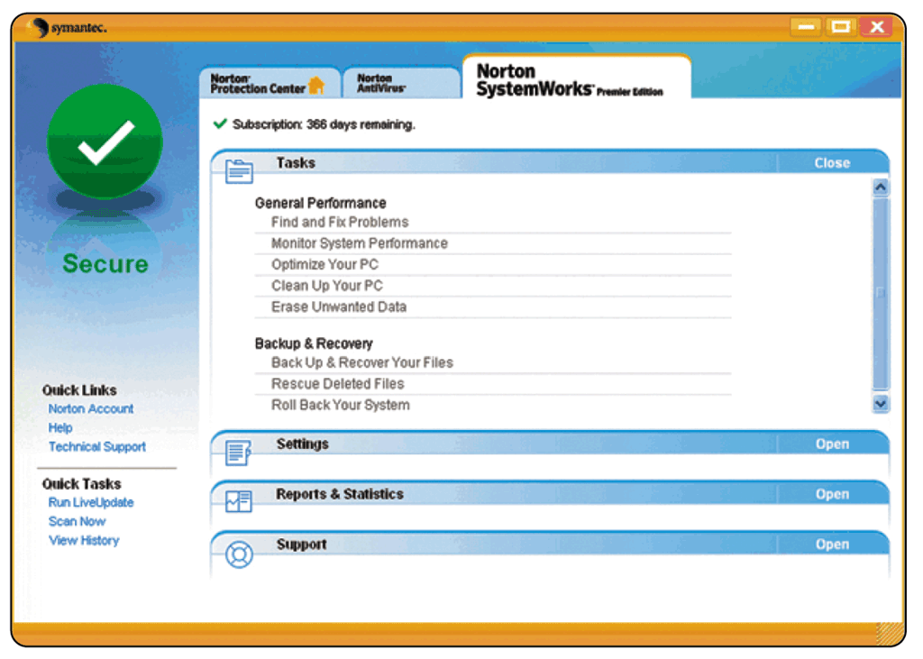
Stand-Alone Utility Programs
What is a personal computer maintenance utility?
Identifies and fixes operating system problems and disk problems
Some continuously monitor computer to identify problems before they occur
p. 428 Fig. 8-40
Next

Slide 34
Types of Operating Systems
What are some characteristics of operating systems?
Proprietary software
Privately owned and limited to specific vendor or computer model
Device-dependent
Runs only on specific type of computer
Device-independent
Runs on many manufacturers’ computers
Downward compatible
Works with application software written for earlier version of operating system
Upward compatible
Runs on new versions of operating system
Click to view Web Link, click Chapter 8, Click Web Link from left navigation, then click Windows Vista below Chapter 8
p. 415 - 416
Next

Slide 35
Types of Operating Systems
What are three categories of operating systems?
Embedded
Network
Stand-alone
p. 416
Next

Slide 36
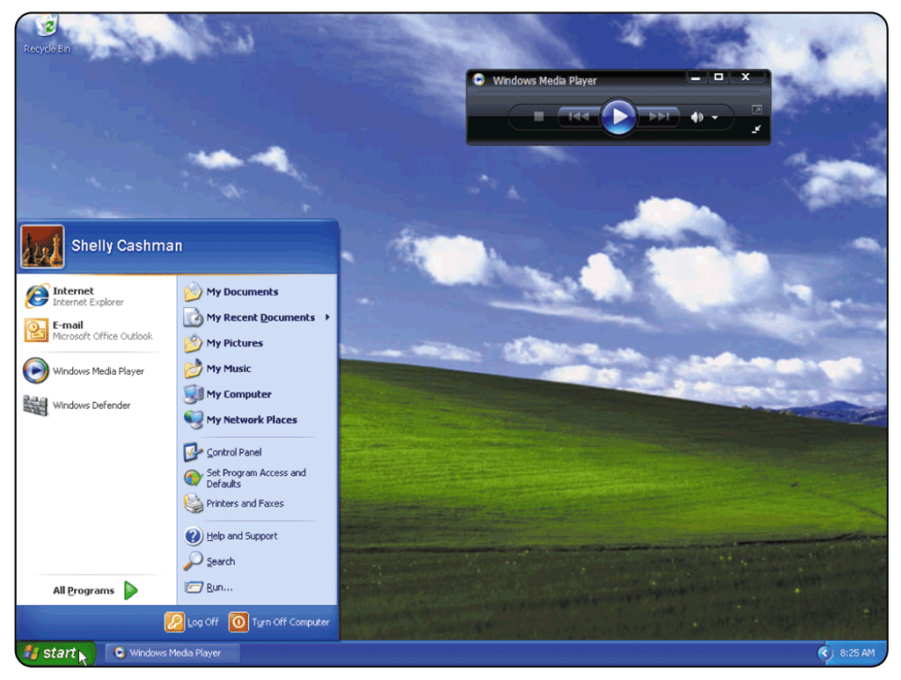
Stand-Alone Operating Systems
What is Windows XP?
Fast, reliable Windows operating system
Available in five editions: Home Edition, Professional Edition, Tablet PC Edition, Media Center Edition, and 64-bit Edition
p. 417 - 418 Fig. 8-24
Next

Slide 37
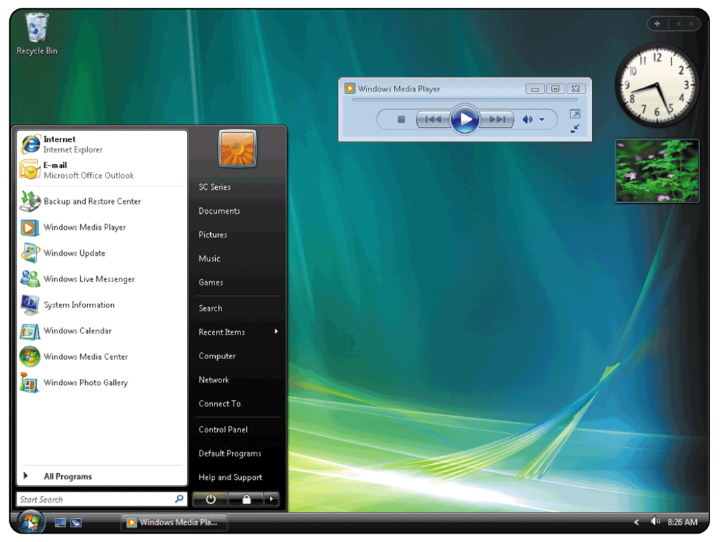
Stand-Alone Operating Systems
What is Windows Vista?
Successor to Windows XP, containing a new interface and new / enhanced features
Available in several editions, grouped into Home and Business categories
p. 418 - 419 Fig. 8-25
Next

Slide 38
Stand-Alone Operating Systems
What are some features of Windows Vista?
Windows Vista Features
Reliability and Performance
Security
Information Management
Appearance and Navigation
Communications and the Internet
p. 419
Next

Slide 39
Stand-Alone Operating Systems
How do Windows versions compare?
Windows Version Year Released
Windows 3.x 1990
Windows NT 3.1 1993
Windows 95 1995
Windows NT Workstation 4.0 1996
Windows 98 1998
Windows Millennium Edition 2000
Windows 2000 Professional 2000
Windows XP 2001
Windows XP SP2 2004
Windows Vista 2006
p. 417 Fig. 8-23
Next

Slide 40
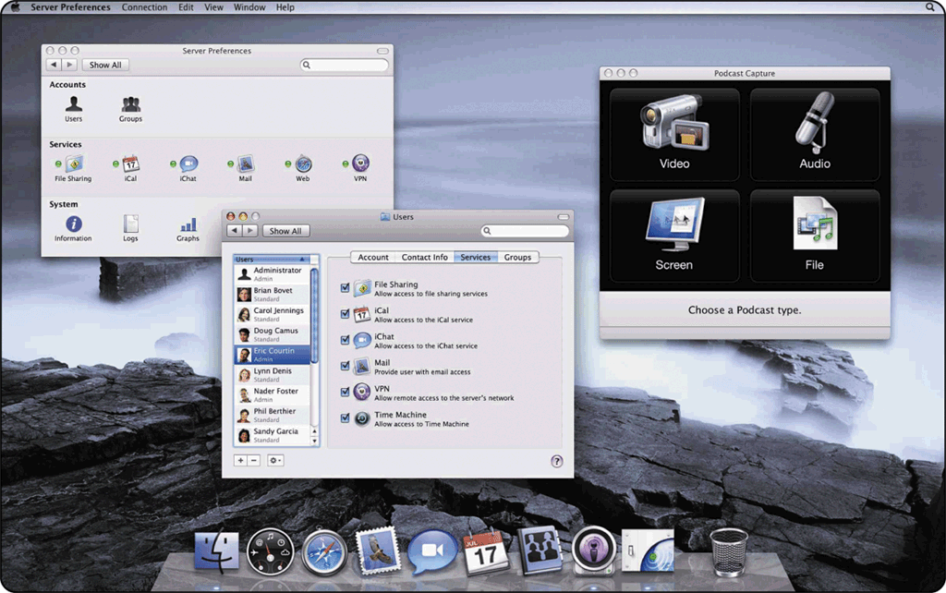
Stand-Alone Operating Systems
What is Mac OS X?
Available only for computers manufactured by Apple
Macintosh operating system has been model for most GUIs
Click to view Web Link, click Chapter 8, Click Web Link from left navigation, then click Mac OS X below Chapter 8
p. 420 Fig. 8-28
Next

Slide 41
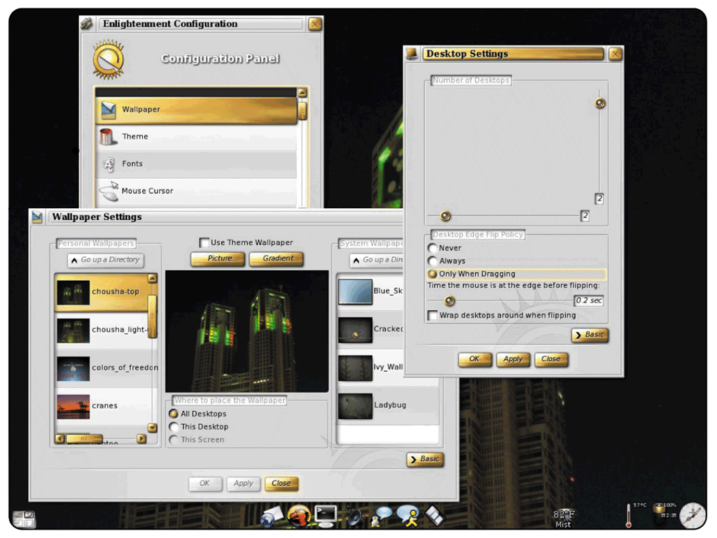
Stand-Alone Operating Systems
What is UNIX?
Used by power users because of its flexibility and power
Most versions offer GUI
Available for computers of all sizes
p. 420 Fig. 8-29
Next

Slide 42
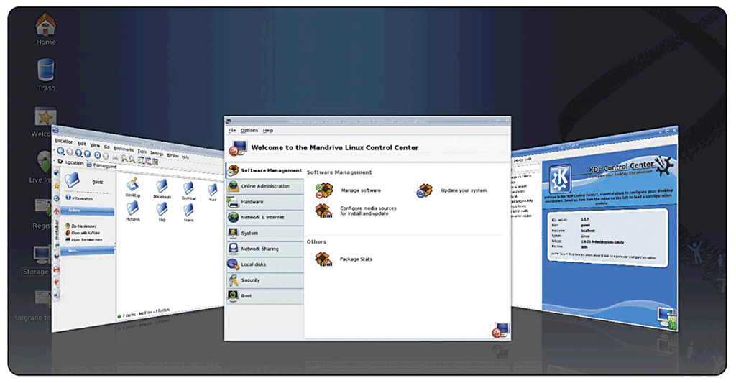
Stand-Alone Operating Systems
What is Linux?
Popular, free, multitasking UNIX-type operating system
Open-source software— code is available to public
Both a stand-alone and a network operating system
Click to view Web Link, click Chapter 8, Click Web Link from left navigation, then click Linux below Chapter 8
p. 421 - 422 Fig. 8-30
Next

Slide 43
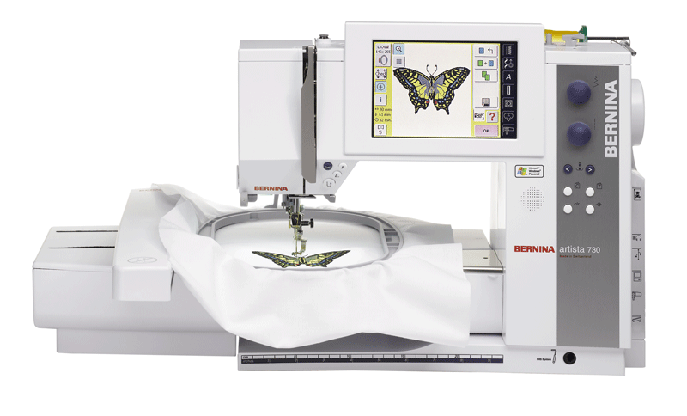
Embedded Operating Systems
What is an embedded operating system?
Found on most smart phones and small devices
Windows Embedded CE is scaled-down version of Windows
p. 423 Fig. 8-31
Next

Slide 44
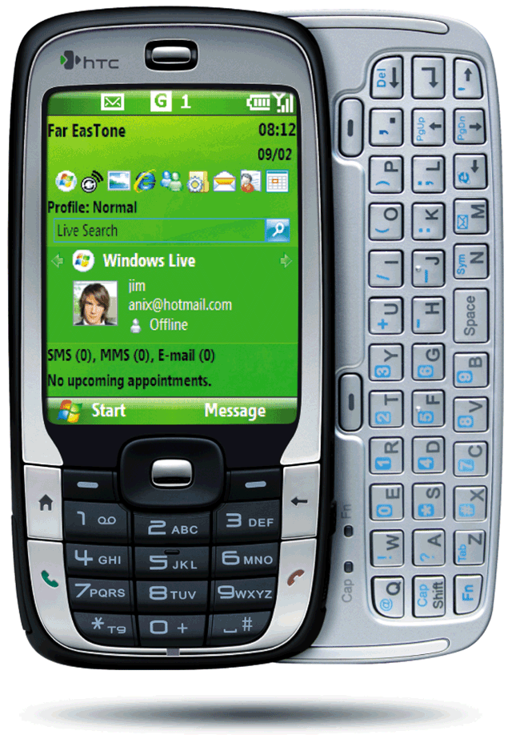
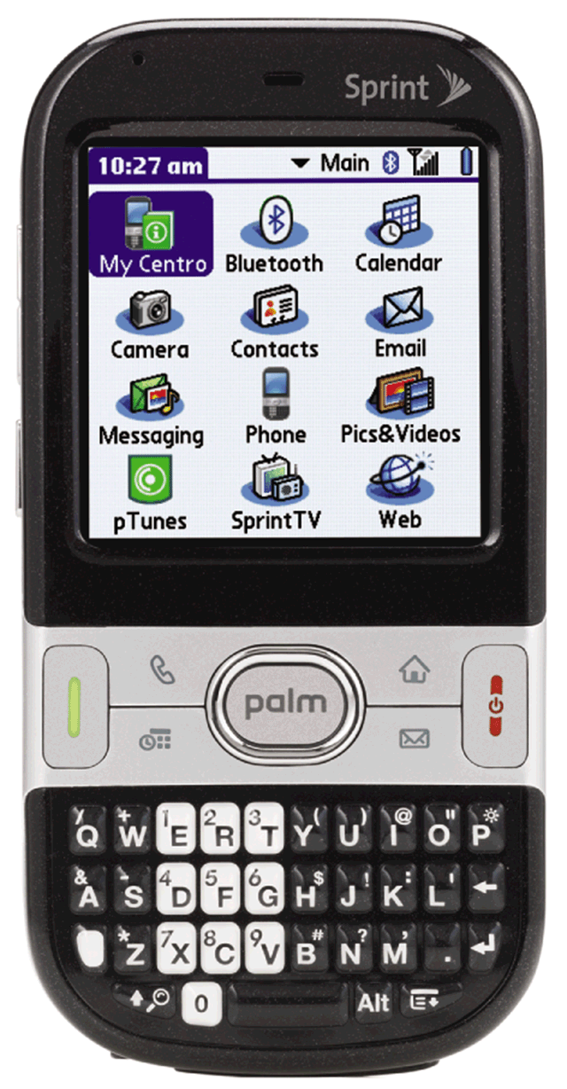
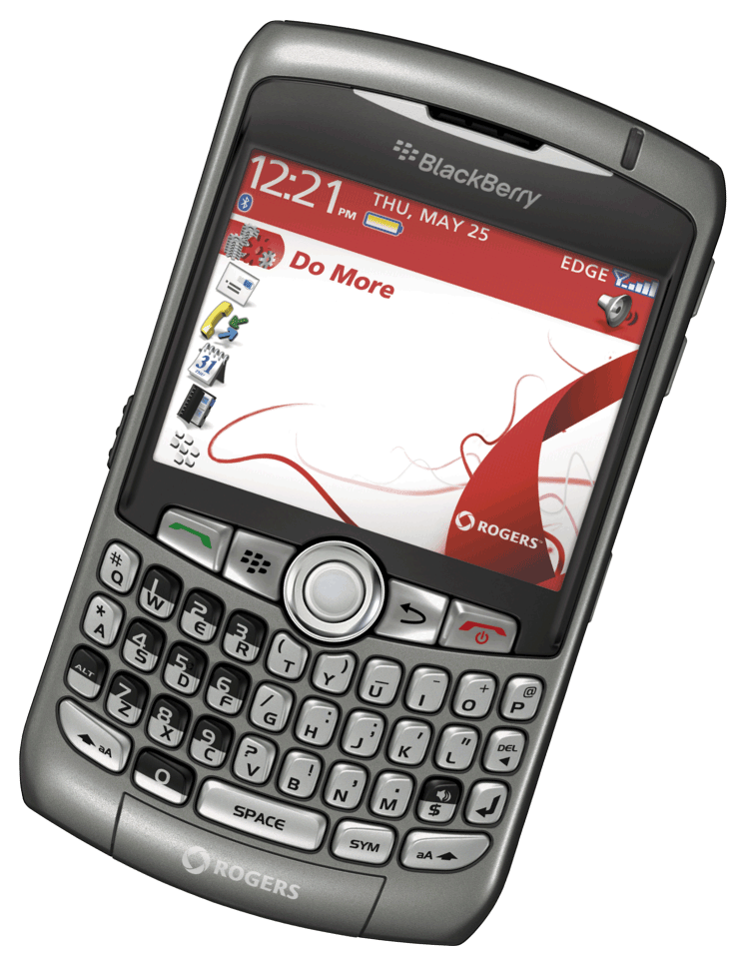
Embedded Operating Systems
What are three operating systems for PDAs?
Windows Mobile for Pocket PC
Palm OS for Palm
Blackberry
Click to view Web Link, click Chapter 8, Click Web Link from left navigation, then click Windows Mobile below Chapter 8
Click to view Web Link, click Chapter 8, Click Web Link from left navigation, then click BlackBerry below Chapter 8
p. 424 - 425 Figs. 8-32 - 8-34
Next

Slide 45
Embedded Operating Systems
What is Embedded Linux?
Scaled-down Linux operating system designed for smart phones, PDAs, smart watches, set-top boxes, Internet telephones, and other devices
Offers many PIM functions
p. 425
Next

Slide 46
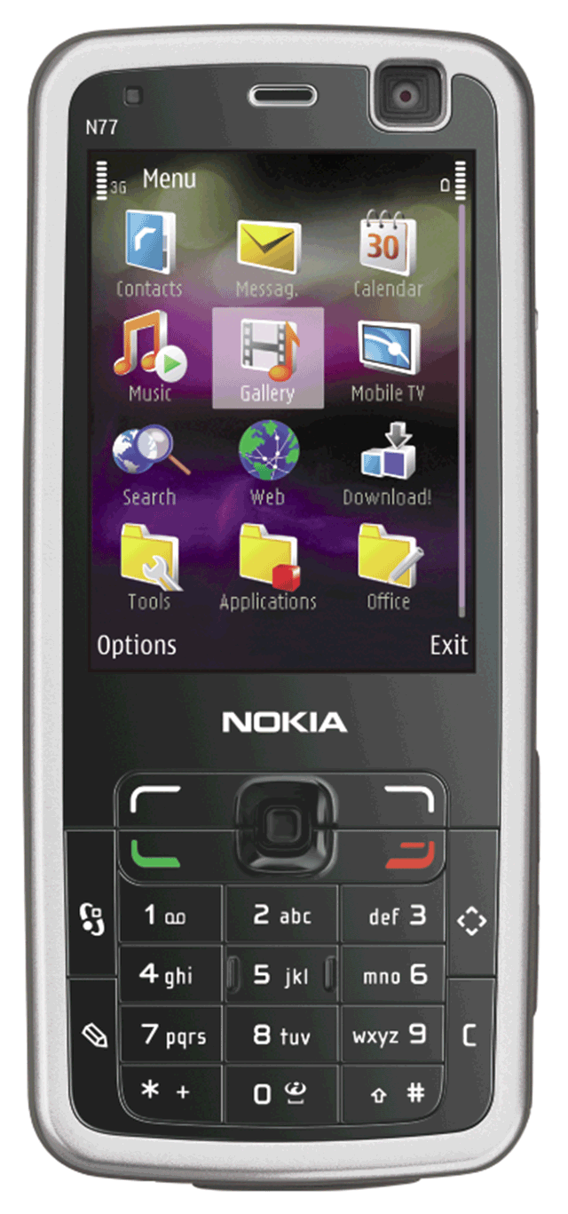
Embedded Operating Systems
What is Symbian OS?
Open-source, multitasking operating system designed for smart phones
Make telephone calls, save appointments, browse Web, send and receive text and picture messages, e-mail messages, faxes, and more
p. 425 Fig. 8-35
Next

Slide 47
Network Operating Systems
What are examples of network operating systems?
NetWare
Designed for client/server networks
UNIX / Linux
Multi-purpose operating system
Windows Server 2008
Upgrade to Windows 2003 Server
Solaris
Version of UNIX developed by Sun Microsystems
Specifically for e-commerce applications
Click to view Web Link, click Chapter 8, Click Web Link from left navigation, then click Windows Server 2008 below Chapter 8
p. 422 - 423
Next

Slide 48
Stand-Alone Utility Programs
What is a virus?
Potentially damaging computer program
Affects computer without user’s knowledge
An unusual message or image is displayed on the computer screen
An unusual sound or music plays randomly
The available memory is less than what should be available
A program or file suddenly is missing
An unknown program or file mysteriously appears
The size of a file changes without explanation
A file becomes corrupted
A program or file does not work properly
System properties change
The operating system runs much slower than usual
SIGNS OF VIRUS INFECTION
p. 425 - 426 Fig. 8-36
Next

Slide 49
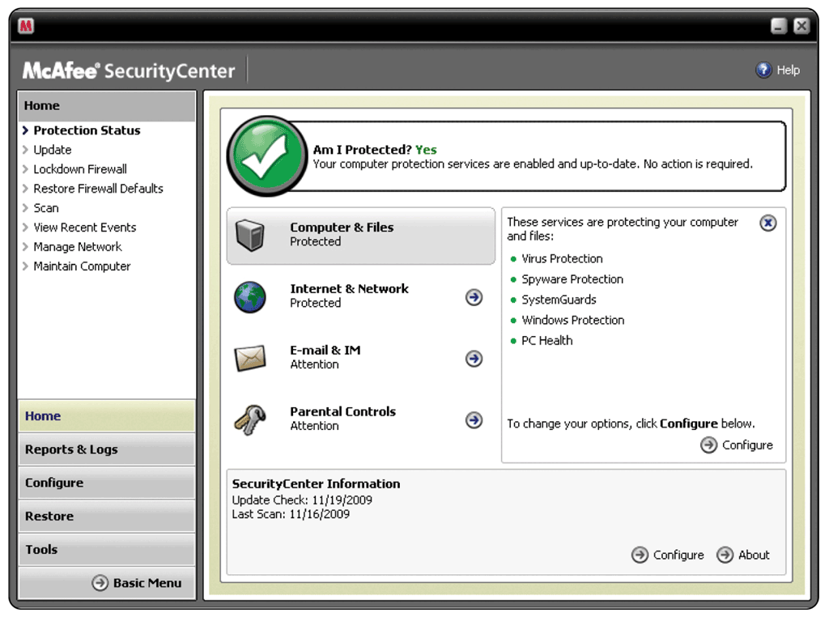
Stand-Alone Utility Programs
What is an antivirus program?
Identifies and removes viruses in memory, storage media, and incoming files
Must be updated frequently
p. 426 Fig. 8-37
Next

Slide 50
Stand-Alone Utility Programs
What is spyware?
Program placed on a computer without the user’s knowledge that secretly collects information about the user
Often enters a computer as a result of a user installing a new program
A spyware remover is a program that detects and deletes spyware
p. 427
Next

Slide 51
Stand-Alone Utility Programs
What are internet filters?
Programs that remove or block certain items from being displayed
Anti-Spam
Programs
Web Filters
Phishing Filters
Pop-up Blockers
Click to view Web Link, click Chapter 8, Click Web Link from left navigation, then click Phishing Filters below Chapter 8
p. 427
Next

Slide 52
Summary of Operating Systems and Utility Programs
Define an operating system
Discuss a variety of stand-alone operating systems, network operating systems, and embedded operating systems
Discuss the functions common to most operating systems
Describe several stand-alone utility programs
Introduce several utility programs commonly found in operating systems
Chapter 8 Complete

